Slide 1
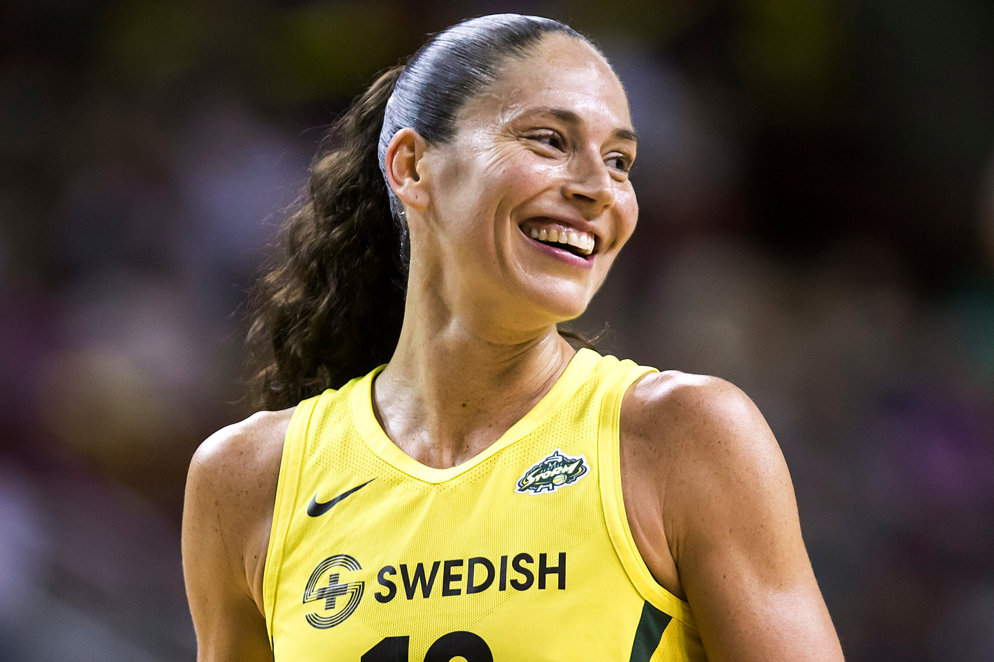
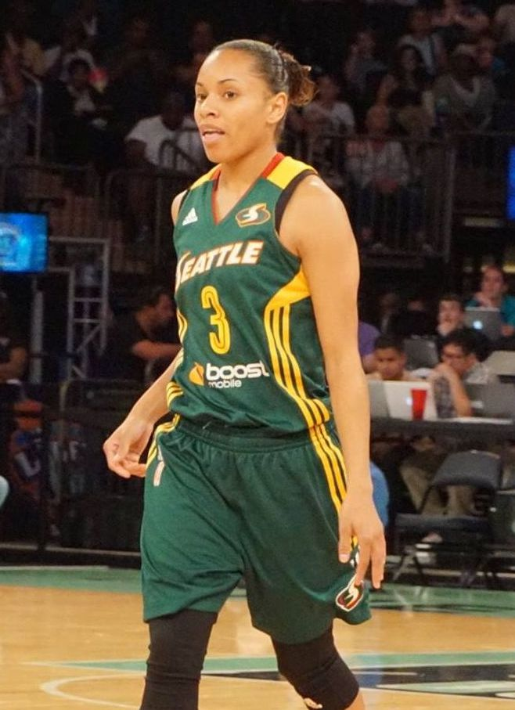

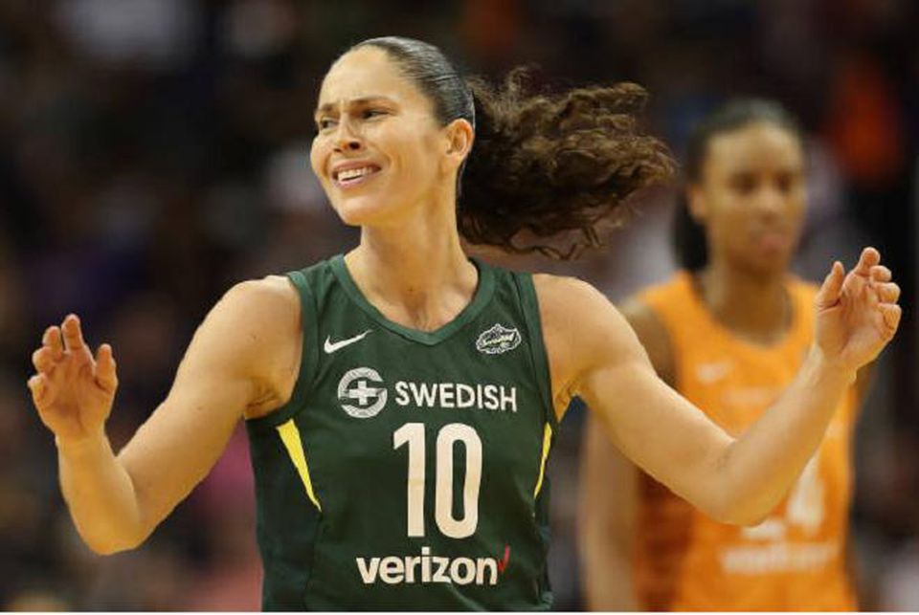
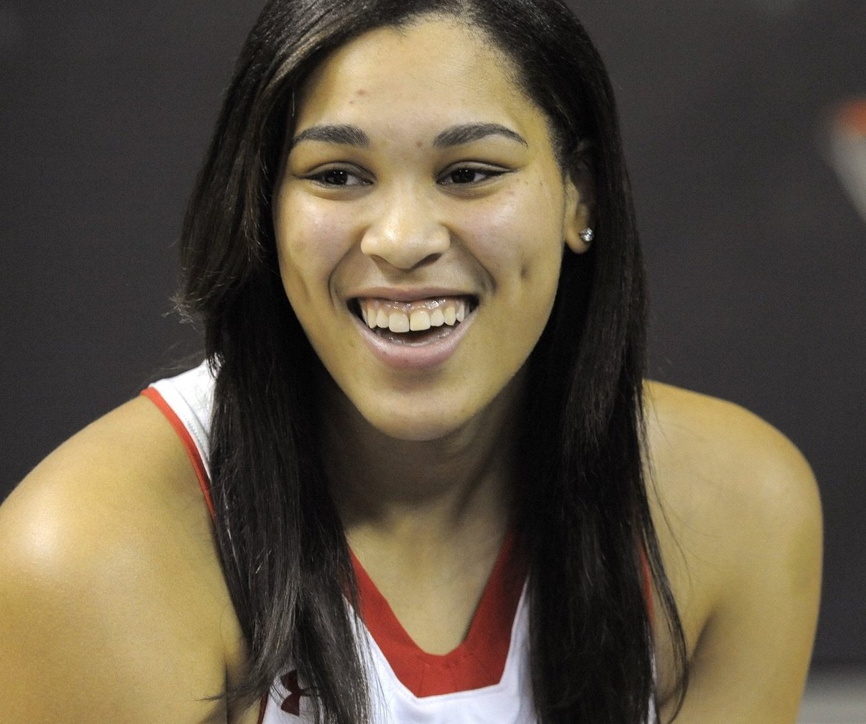
Does age matter?
younger
VS
Angel Robinson
& Brionna Jones
(21 years old)
Sue Bird
(36 years old)
older

Slide 2
Does age matter?
Average age in the sample is 27.11 years old to be precise.
Ages range from 21 till 36

Slide 3
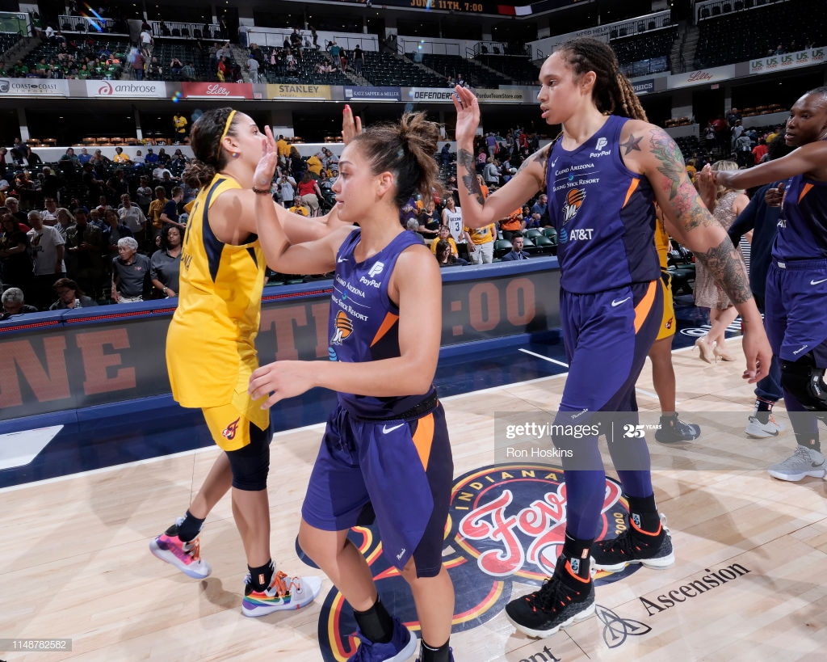
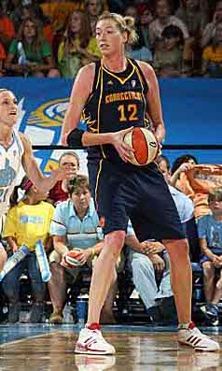
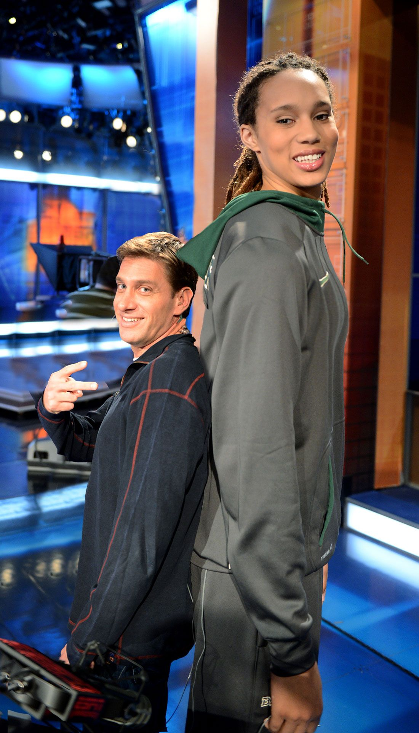
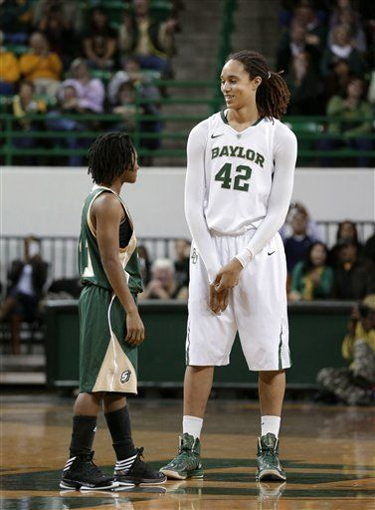
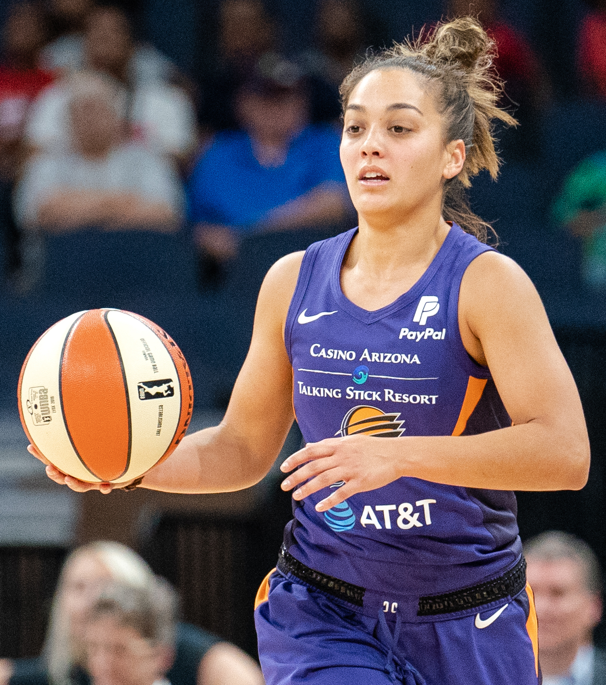
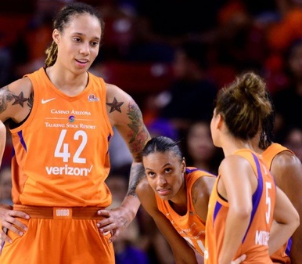
Does height matter?
Brittney Griner
(206 cm)
taller
VS
Leilani Mitchell
(165 cm)
shorter

Slide 4
Does height matter?
Average height in the wnba sample is 184.6 cm
Height range from 165 cm till 206 cm
The average height of women in the US is 161.5 cm (source Wikipedia)
We did a statistical T test which gave a p-value of 2.915 e-66.
So we can say with 95% certainty that the average height of women playing in the wnba
is NOT the same as the average height of women in the US.

Slide 5
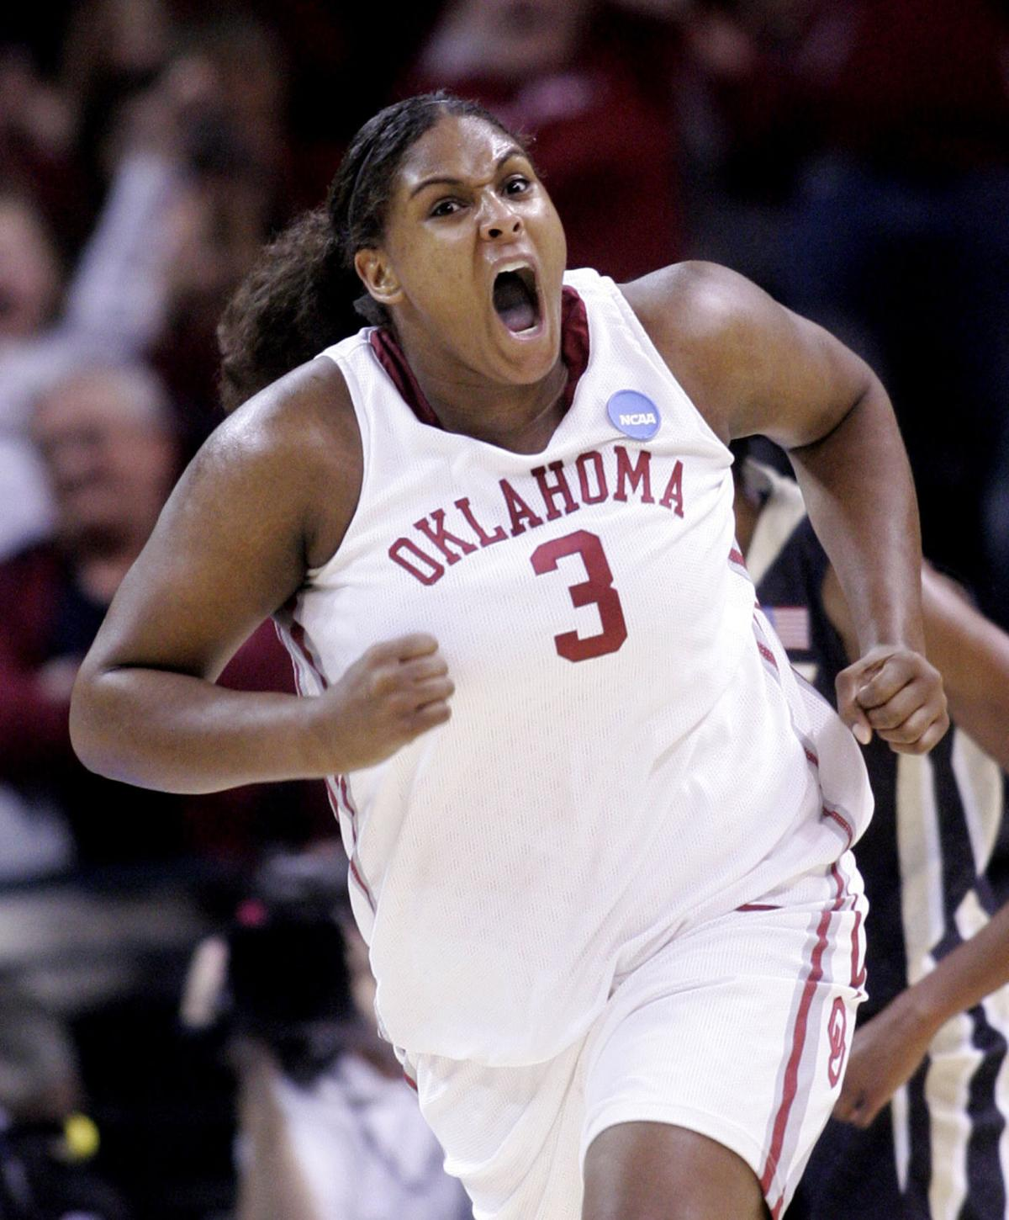
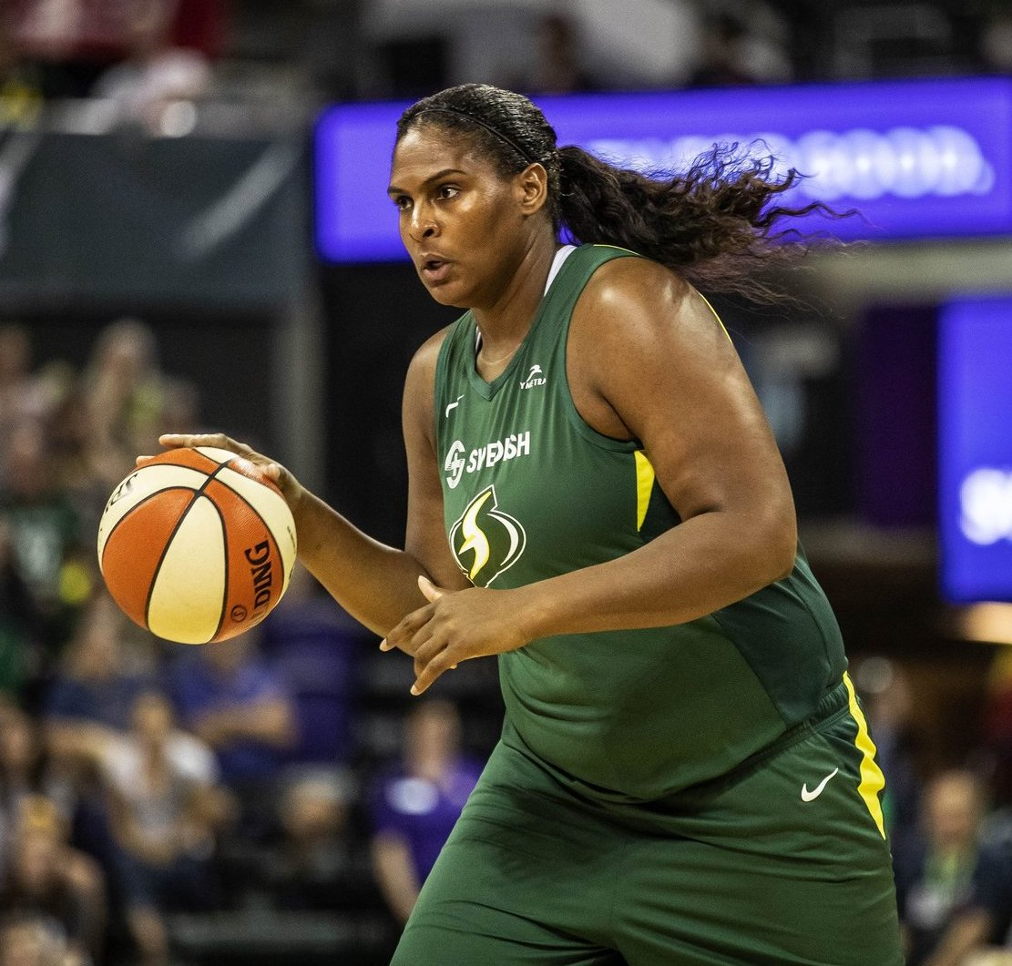
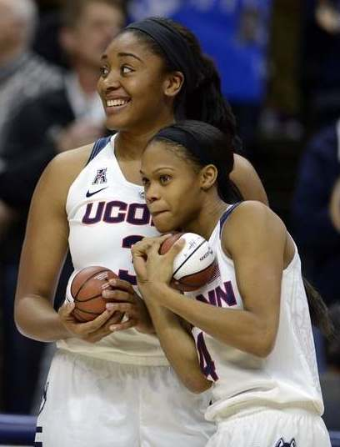
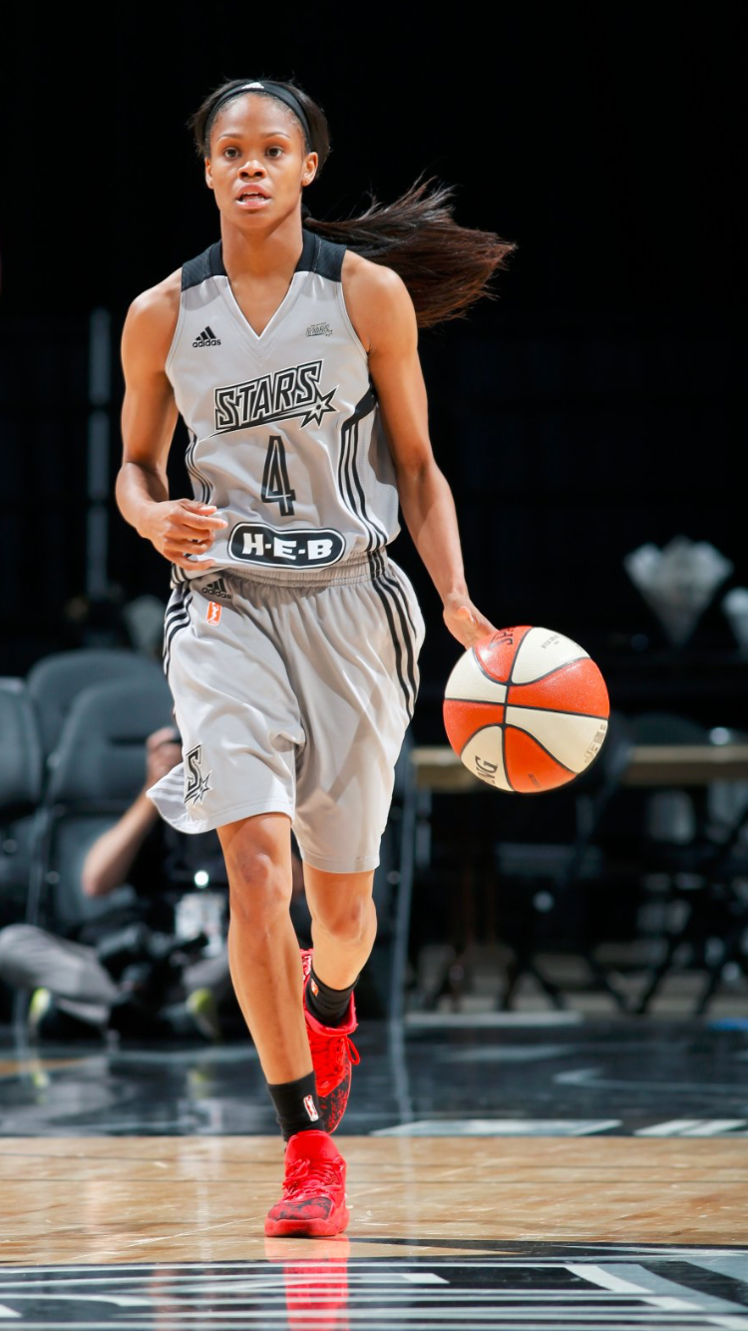
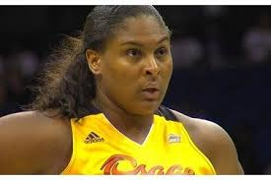
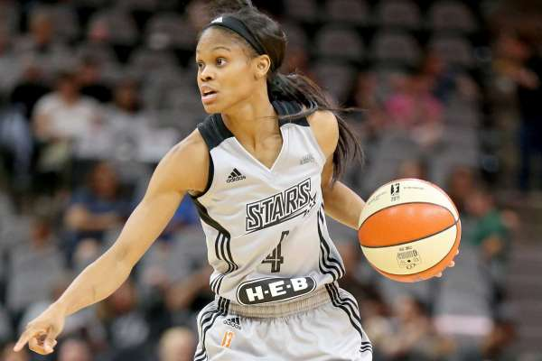
Does weight matter?
lighter
Moriah Jefferson
(55 kg)
VS
heavier
Courtenay Paris
(113 kg)

Slide 6
Does weight matter?
Average height in the wnba sample is 78.98 kg
Weight range from 55 kg till 113 kg
The average weight of women in the US is 76.4 kg (source Wikipedia)
We did a statistical T test which gave a p-value of 0.00295
So we can say with 95% certainty that the average weight of women playing in the wnba
is NOT the same as the average weight of women in the US.

Slide 7
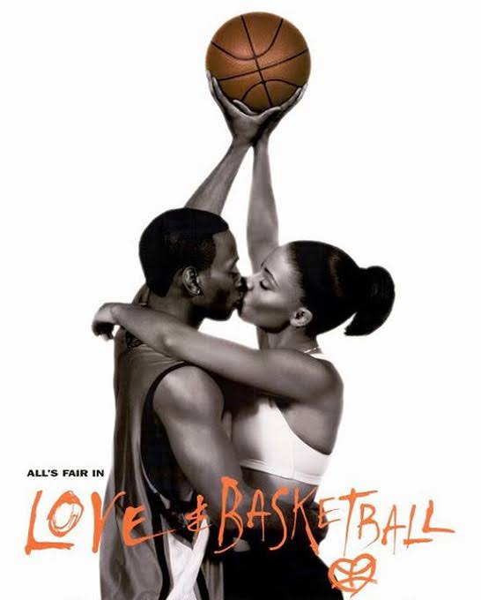
It is all about L.O.V.E.

